Slide 1
Food Truck Ordering
9/10/2025
Jaden W, Sean S, and Robert W

Slide 2

Project Overview
We're improving the food truck ordering flow by letting users build their meal, send it as a ticket with an order number, and have it pop up on the employee side for quick fulfillment.
We're using HTML for the frontend interface and C++ for backend functionality, based on the team's familiarity and strengths with each language.
Our implementation bridges frontend and backend through a lightweight workflow, showcasing how simple tools can solve real-world problems when paired with thoughtful design and team collaboration.

Slide 3
Requirements
Functional Requirements 1.1
FR1 – Website Form Submission
ID: FR1
Title: Checkout
Description: The webpage should be able to accept user submission and be able to send it to the backend
Priority: high
Dependency: none

Slide 4
Requirements
Functional Requirements 1.2
FR2 – Submission Handling in Backend
ID: FR2
Title: Backend reception
Description: The back end of the program should be capable of receiving an order from the website.
Priority: High
Dependency: FR1

Slide 5
Requirements
Non-Functional Requirements 1.3
NFR3 – Cart list
ID: NFR3
Title: Cart summary of items
Description: the webapp should show a cart at the bottom next to submit that shows details of everything selected
Priority: low
Dependency: FR1

Slide 6
Requirements
Non-Functional Requirements 1.4
NFR4 – Order Confirmation
ID: NFR4
Title: Order Confirmation Screen
Description: upon submission the order confirmation screen should be shown, and simple details about the order should be shown such as order #, price, items w/ customizations
Priority: low
Dependency: FR1

Slide 7
Requirements
Functional Requirements 1.5
FR5 – Live Order Queue
ID: FR5
Title: Order Queue Display
Description: the food truck side of the program should display the current orders and be capable of marking them as complete and removing orders
Priority: High
Dependency: FR2

Slide 8
Priority of Requirements
FR1 – Website Form Submission
FR2 – Submission Handling in Backend
FR5 – Live Order Queue
NFR3 – Cart list
NFR4 – Order Confirmation

Slide 9
Development Plan - Agile
Requirement work assignment
Design WebApp UI
Develop the backend order handling
Ensure Client Requests Reach Backend
Testing and bug-fixing
Release

Slide 10
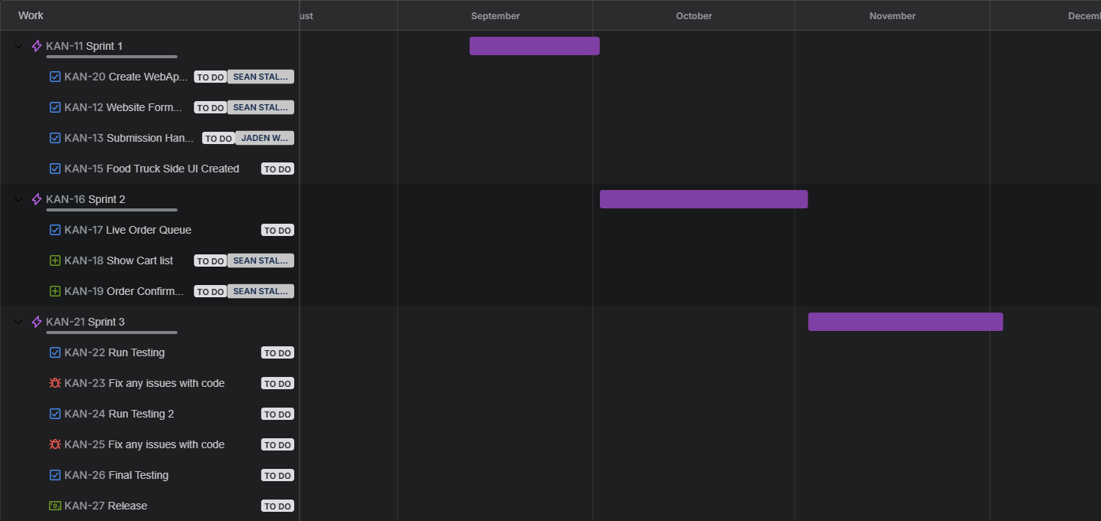
Process Management

Slide 11
Team Roles
Sean Staley – Project Manager / Frontend Engineer
Jaden Wattley – Backend Engineer / Product Engineer
Connor Raque – None
Robert Wickliffe – Full Stack Dev

